Slide 1
Class 3

Slide 2


WELCOME TO CSS
PRESENTATION
MD JASHIM UDDIN
Trainer
Associate Professor
ICT Department,IU
Ibrahim Chowdhury
Lab Assistant
ICT Department,IU

Slide 3
INTRODUCTION TO CSS
CSS stands for Cascading Style Sheets.
It's a style sheet language used for describing the presentation of a document written in HTML.
CSS describes how elements should be rendered on screen, on paper, in speech, or on other media.
It allows for consistent styling across multiple pages of a website.
It controls the layout, colors, fonts, and other visual aspects of a webpage.

Slide 4
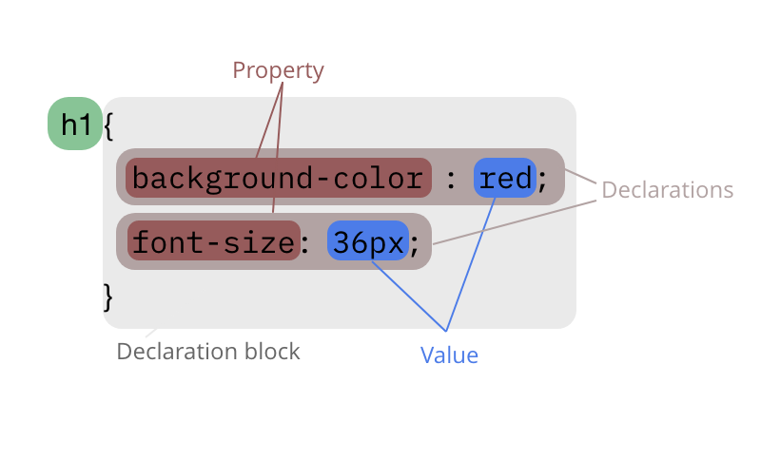
SYNTAX OF CSS
Selector
CSS rules are comprised of a selector and a declaration block.
Selector: Specifies which element(s) the style applies to.
Declaration Block: Consists of one or more declarations separated by semicolons.
Each declaration includes a property and a value, separated by a colon.

Slide 5
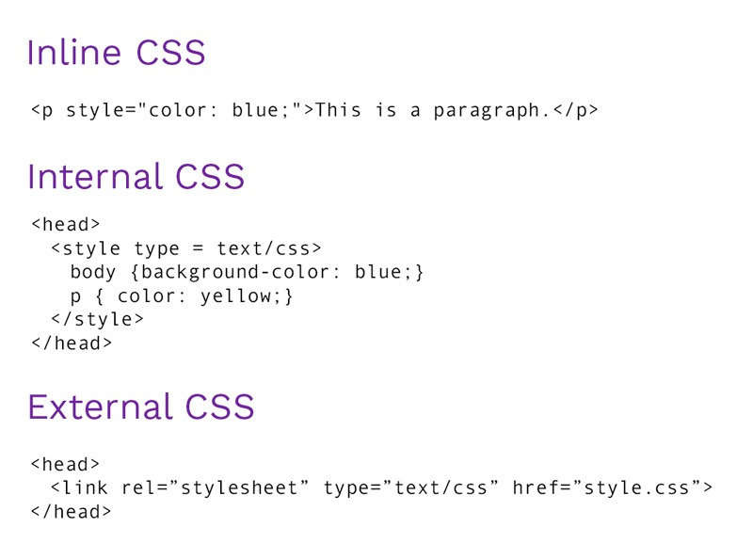
CSS DECLARATION IN HTML
Inline CSS: Style applied directly to an HTML element using the style attribute.
Internal CSS: Style defined within the <style> element in the <head> section of an HTML document.
External CSS: Style defined in a separate CSS file and linked to the HTML document using the <link> element.

Slide 6
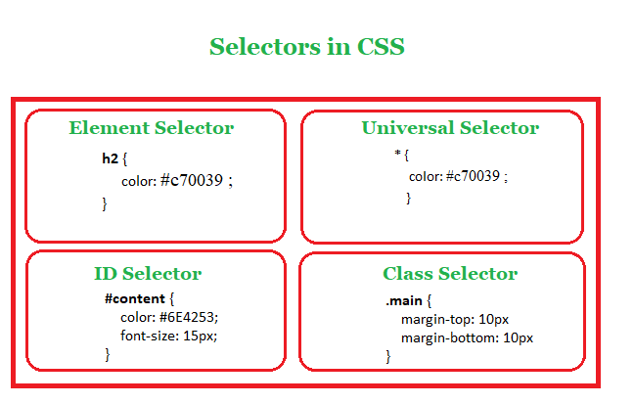
CSS SELECTORS
CSS selectors are patterns used to select elements you want to style.
Basic selectors include:
Element selectors (e.g., p, div)
Class selectors (e.g., .classname)
ID selectors (e.g., #idname)
Other Selectors:
Attribute selectors (e.g., [attribute=value])
Pseudo-classes (e.g., :hover, :nth-child())
Pseudo-elements (e.g., ::before, ::after)

Slide 7
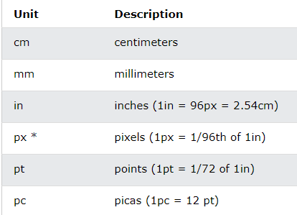
CSS UNITS
CSS supports various units for specifying lengths and sizes, including:
Pixels (px)
Percentages (%)
Em and rem
Viewport units (vw, vh)
Absolute units (in, cm, mm)
Relative units (ex, ch)
Choosing the appropriate unit is important for responsive design and scalability.

Slide 8
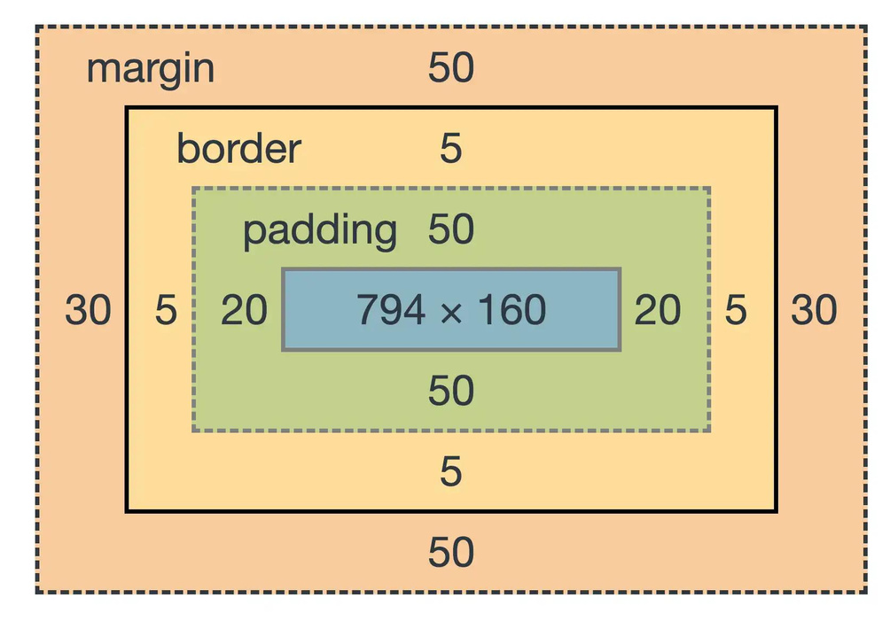
CSS BOX MODEL
The CSS box model describes the space around and within an HTML element.
It consists of content, padding, border, and margin.
Understanding the box model is crucial for layout and positioning in CSS.

Slide 9
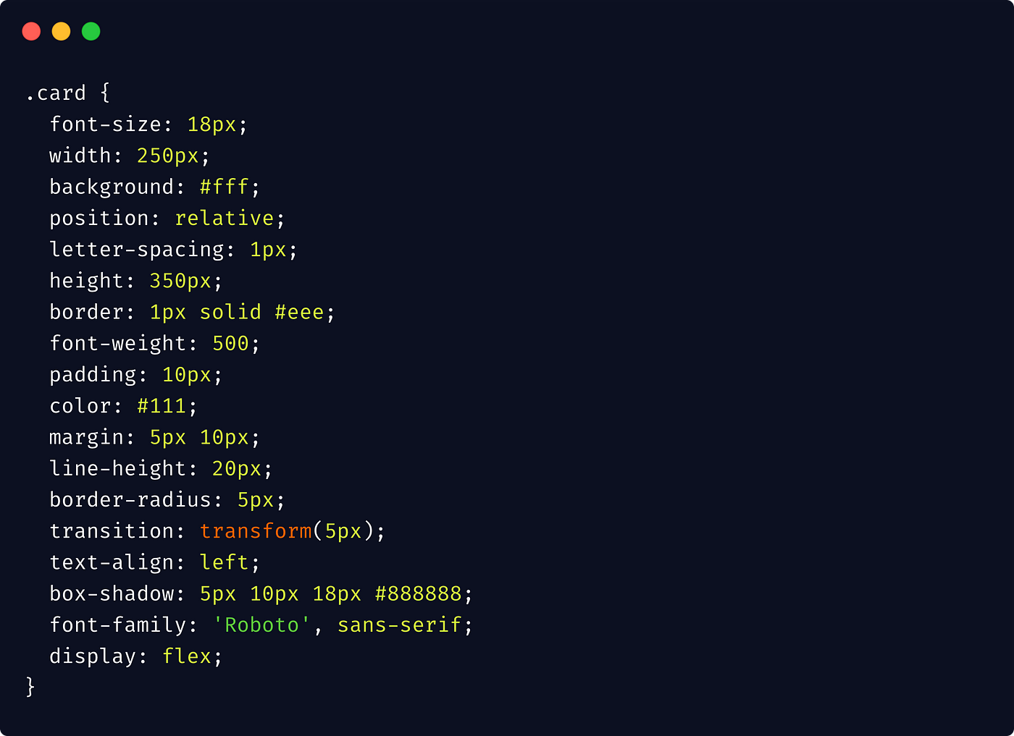
CSS PROPERTIES
CSS offers a wide range of properties to style elements, including:
Color and background properties
Text properties (e.g., font-size, font-family)
Box properties (e.g., width, height, padding, margin)
Positioning properties (e.g., position, top, left)
Display properties (e.g., display, visibility)
Flexbox and Grid properties for advanced layout control

Slide 10
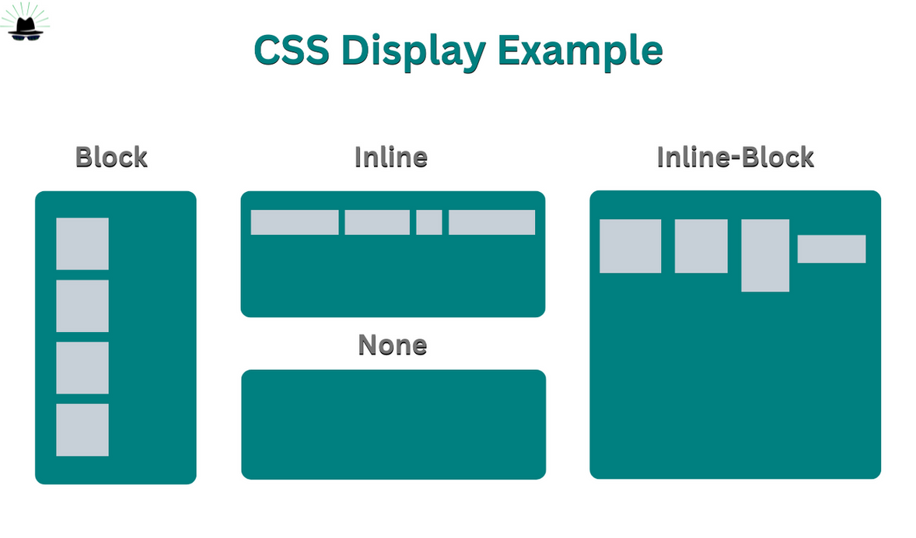
CSS DISPLAY PROPERTY
The display property specifies the type of box an element generates.
Common values include block, inline, inline-block, none, etc.
display: flex and display: grid are powerful layout tools introduced in CSS3.

Slide 11
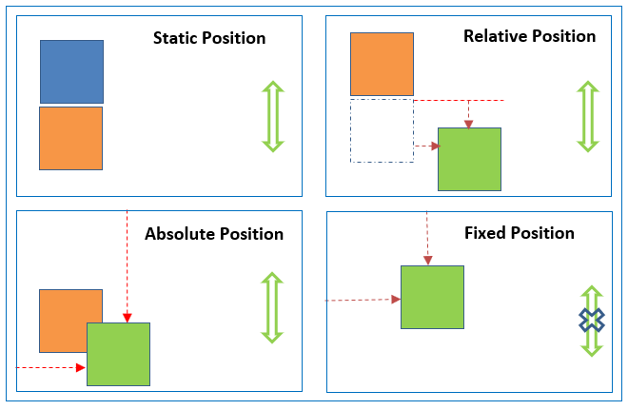
CSS POSITIONING
CSS positioning allows you to precisely control the placement of elements on a webpage.
Common positioning values include static, relative, absolute, and fixed.
Understanding positioning is crucial for creating complex layouts.

Slide 12
Class 4

Slide 13
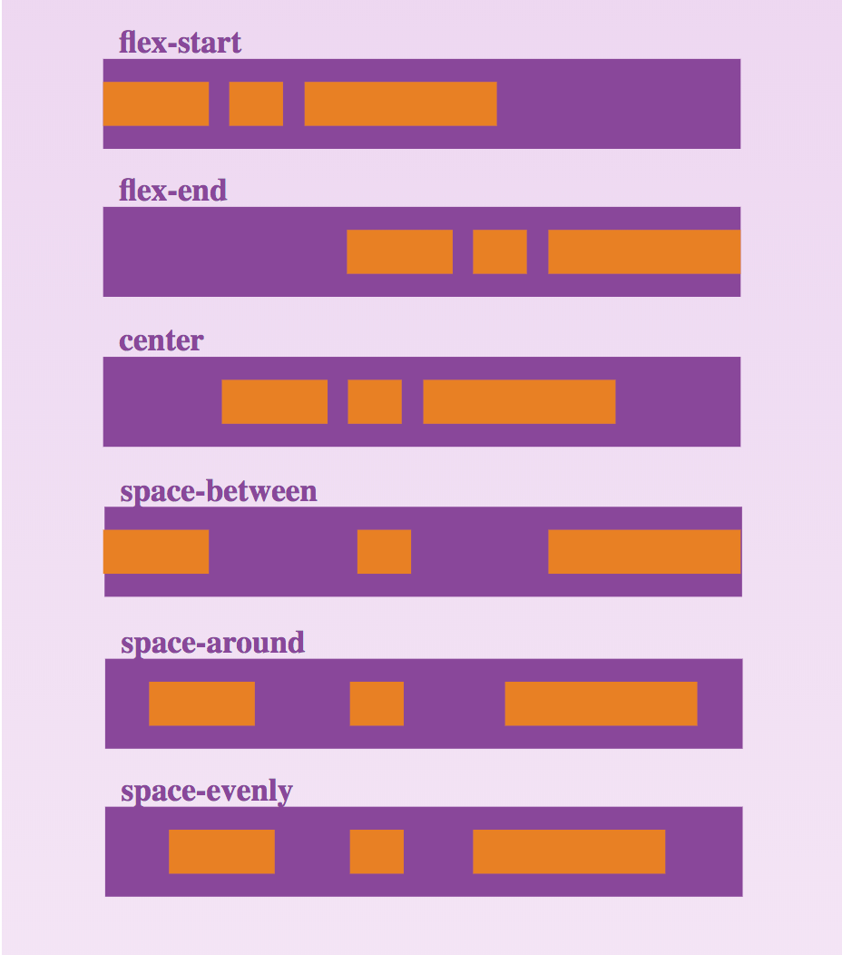
CSS FLEXBOX
Flexbox is a one-dimensional layout method used for laying out items in a row or a column.
It offers powerful alignment and distribution capabilities.
Flexbox is particularly useful for building responsive designs and arranging items within containers.

Slide 14
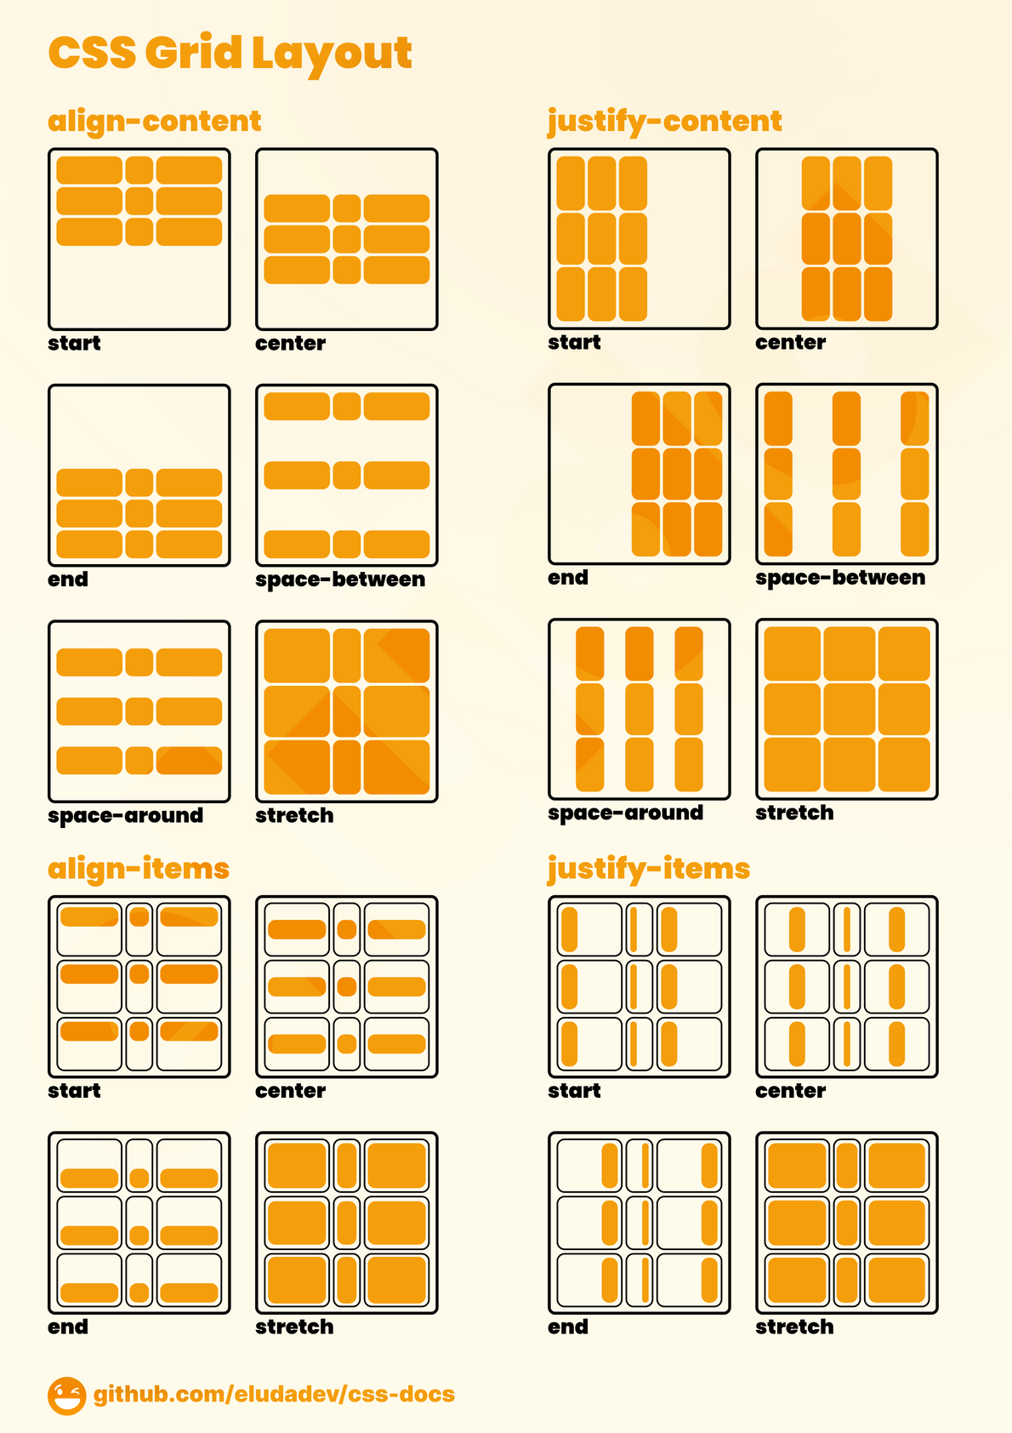
CSS GRID
CSS Grid is a two-dimensional layout system that allows you to create complex grid-based layouts.
It divides a page into rows and columns, making it easy to align and position elements.
CSS Grid is highly versatile and can handle both simple and intricate layouts with ease.

Slide 15
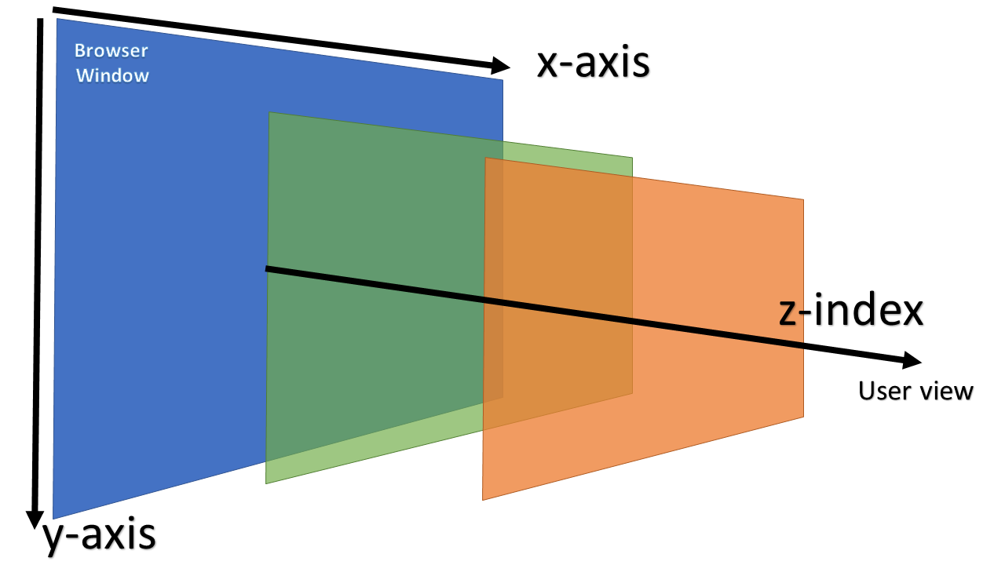
CSS Z-INDEX
The z-index property determines the stacking order of positioned elements.
Elements with a higher z-index value will appear above elements with a lower z-index value.
z-index is essential for controlling the visual hierarchy of overlapping elements.

Slide 16
Class 5

Slide 17
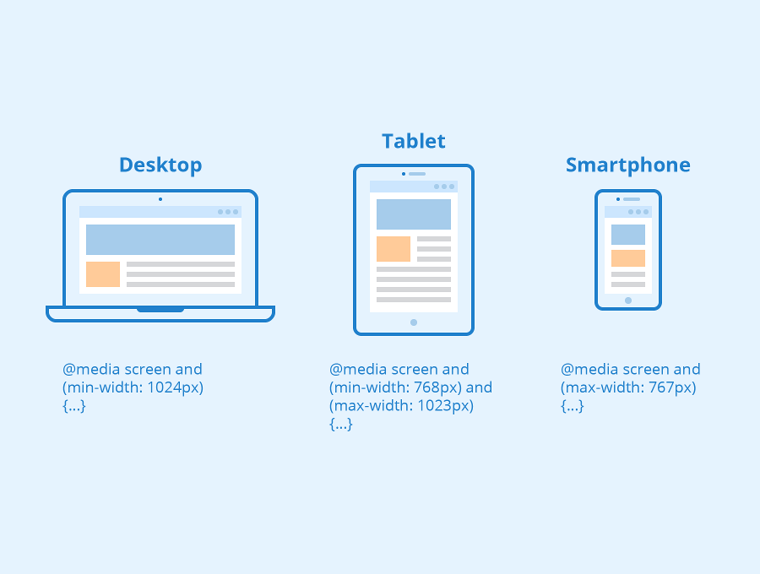
CSS MEDIA QUERIES
Media queries allow you to apply different styles based on various device characteristics, such as screen size, resolution, and orientation.
They enable the creation of responsive designs that adapt to different devices and screen sizes.
Media queries are essential for ensuring a consistent user experience across devices.

Slide 18
CSS BEST PRACTICES
Maintain consistent naming conventions and formatting.
Minimize redundant code, use shorthand properties, and optimize selectors.
Test across different browsers and devices for consistent rendering.

Slide 19
CSS FRAMEWORKS
Frameworks are Pre-written, standardized code libraries that provide a structure for styling web pages.
They are used for faster development, responsive design, browser compatibility, consistent styling.
Popular CSS Frameworks are,
Bootstrap
Tailwind

Slide 20
CONCLUSION
CSS is a fundamental technology for styling web pages and creating visually appealing designs.
Understanding CSS syntax, selectors, properties, and layout models like Flexbox and Grid empowers developers to create modern and responsive websites.
Continuous learning and exploration of CSS capabilities are essential for staying updated with the latest web design trends and best practices.

Slide 21
Thank You So Much

